Slide 1
Complete your summary for last lesson by answering the EQ: How do I convert between fractions, decimals and percentages?
To convert a __________ into a __________ I need to divide the n___________ by the d_____________.
Then to convert the decimal into a _____________ I multiply it by _____.
Percentage means ______ of _____.
Notes:
To calculate the percentage of a number first I need to convert the percentage into a fraction. Then the number also needs to become a fraction over one. Then I multiply the fractions using the rules of fraction multiplication.

Slide 2
Topic: Percentages
EQ: How do I find the percentage of a number or quantity?
Rule up for 3-column notes! ☺

Slide 3
Topic: Percentages
EQ: How do I find the percentage of a number or quantity?
Questions:
Explanation:
Examples:
When is being able to calculate percentages useful?
Retail discounts,
Interest rates,
Personal improvements,
Salary increases,
commission rates and more.
Being able to calculate percentages is an important life skill.
Can you think of any more?

Slide 4
Topic: Percentages
EQ: How do I find the percentage of a number or quantity?
Questions:
Explanation:
Examples:
Finding 10% of a quantity is the same as dividing the quantity by 10
10% of 50 is 5
Which is the same as 50÷10
How do I calculate 10%?
How do I calculate 50%?
Finding 50% of a quantity is the same as dividing the quantity by 2 (halving it)
50% of 50 is 25
Which is the same as 50÷2
How do I calculate 1%?
1% of 50 is 0.5
Which is the same as 50÷100
Finding 1% of a quantity is the same as dividing the quantity by 100

Slide 5

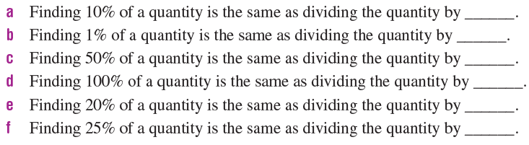
Think-Pair-Share
Left-Hand-Side Task 1
#teamwork
In pairs try filling in the blanks:
10
100
2
1
5
4
Notes:
¼ = 0.25 = 25%
7/8 = 0.875 = 87.5%
2/3 = 0.667 = 66.7%
5/4 = 1.25 = 125%

Slide 6
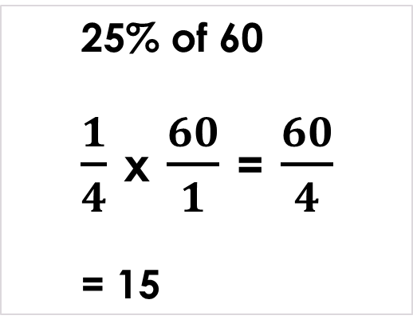
Topic: Percentages
EQ: How do I find the percentage of a number or quantity?
Questions:
Explanation:
Examples:
How do I calculate the percentage of a number?
Express the percentage as a fraction.
Change the ‘of’ to a multiplication sign.
Express the number as a fraction (over 1).
Follow the rules for multiplication of fractions.
25% of 60
$\frac{1}{4}$ x $\frac{60}{1}$ = $\frac{60}{4}$
= 15

Slide 7
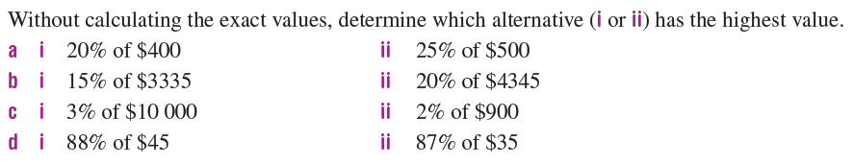
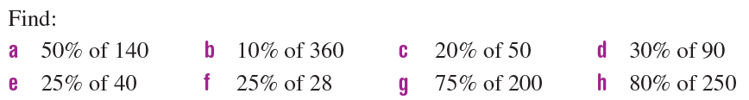
Left-Hand-Side Task 2

Slide 8
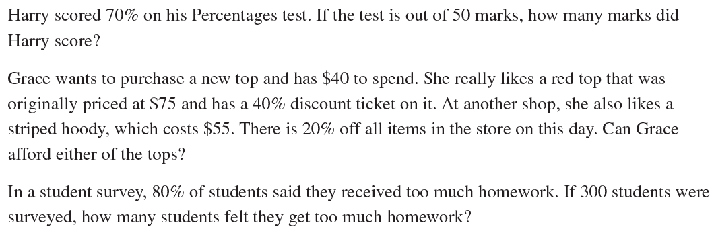
Left-Hand-Side Task 3
1.
2.
3.
Notes:
35
Grace can’t afford either
240

